Slide 1

Introduction to Data Science Lecture 2 – Notations and Definitions
Chapter 1 – Introduction (pp. 1-7)
Chapter 2 – Notation and Definitions (pp. 15-20)
Ph.D. Vahan Sargsyan

Slide 2
Materials covered in previous lecture
Data Science as a Profession
Machine learning = Coding + Statistics
Doing things without being
explicitly programmed to do so.
Econometrics and Statistics
Learn what to do based on
Patterns in the data (learning).
Statistics and Mathematics
Machine Learning
Traditional Research
Coding
Data Science
Field-specific knowledge
(Domain)
Danger Zone

Slide 3
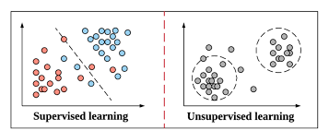
Types of Learning (based on data labels)
Supervised learning | Unsupervised learning
Collection of labeled examples – the train data sample contains the “correct answer” | Collection of unlabeled examples – the data does not contain the “correct answer”
Task example: differentiate apples from bananas based on the degree of their yellow-ness, and red-ness. | Task example: Group individuals into Groups 1 and 2 based on their age and height.

Slide 4
Types of Learning (based on data labels)
Supervised
Collection of labeled examples
Unsupervised
Collection of unlabeled examples
Semi-supervised
Collection of both labeled and unlabeled examples – using many unlabeled examples can help the learning algorithm to find a better model.
Reinforcement
Subfield of machine learning where machine “lives” in an environment and is capable of perceiving the state of that environment as a vector of features.

Slide 5
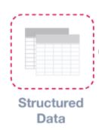
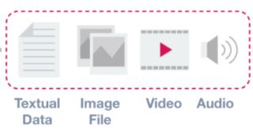
Types of Data (based on data structure)
Structured | Unstructured
data that adheres to a pre-defined data model and is therefore straightforward to analyze. Relationship between the different rows and columns. | information that either does not have a predefined data model or is not organized in a pre-defined manner. Typically text-heavy, but may contain data such as dates, numbers, and facts.
Examples: spreadsheets, relational databases. | Examples: audio, video files, pdf documents, etc.

Slide 6
Types of Data (based on data structure)
Structured
Relationship between the different rows and columns.
Unstructured
Text-heavy, but may contain data such as dates, numbers, and facts
Semi-structured
A form of structured data that does not conform with the formal structure of data models associated with relational databases or other forms of data tables. (Example: JSON files).
Metadata - Data about Data
Provides additional information about a specific set of data. (Example: date and location information in a set of photographs).

Slide 7
Types of Structured Data Inputs
Random Variable (X)
Discrete – takes on only a countable number of distinct values (apple, banana,… ; red, yellow, blue,…; OR 1, 2, 3, … )
Continuous – takes a infinite number of possible values in some interval (age, height, weight, time, …)
Parameters – variables that define the model “learned” by the learning algorithm (i.e. directly modified by the learning algorithm based on the train data).
Hyper-parameters – variables that are directly set by the data analyst before running the algorithm.

Slide 8
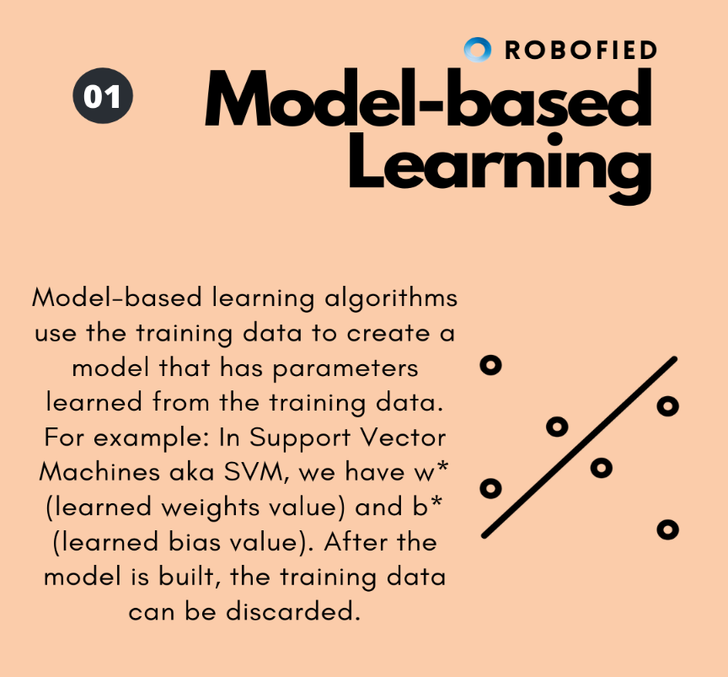
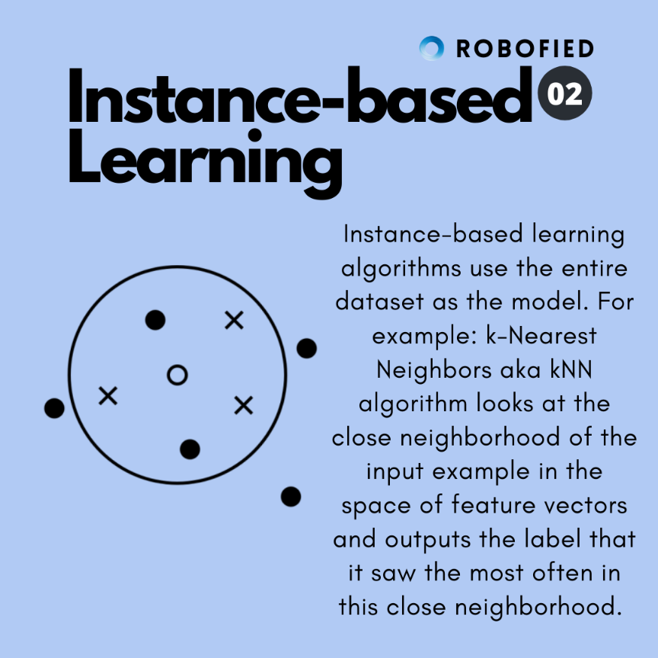
Types of Learning (based on structured data Input)
Model-based learning | Instance-based learning
algorithms use the training data to create a model that has parameters learned from the training data. | algorithm uses the whole dataset as the model.

Slide 9
Types of learning models: (Regression vs. Classification)
Regression | Classification
Regression is a problem of predicting a real-valued label (often called a target) given an unlabeled example. | Classification is a problem of automatically assigning a label to an unlabeled example.
Regression learning algorithm takes a collection of labeled examples as inputs and produces a model that can take an unlabeled example as input and output a target. | Classification learning algorithm takes a collection of labeled examples as inputs and produces a model that can take an unlabeled example as input and either directly output a label or output a number that can be used by the analyst to deduce the label.
Example: Income prediction (outputs an estimate value of income) | Example: Spam detection (outputs a classification value of either spam or not spam)

Slide 10
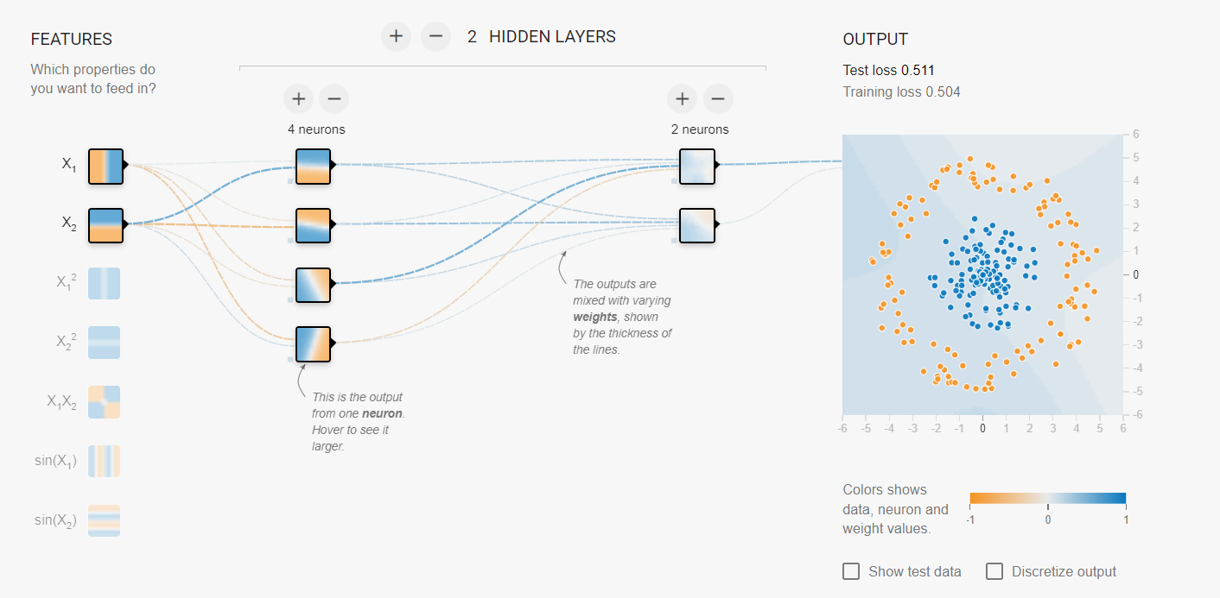
Types of Learning (based on layers between input and output)
Shallow learning | Deep learning
algorithm learns the parameters of the model directly from the features of the training examples | algorithm learns the parameters of the model from the outputs of the preceding layers
Example: Simple Regression | Example: Neural Network (http://playground.tensorflow.org/)

Slide 11

Quiz in the Beginning of Next Class!
Quizzes - 20% of final Grade
Do not be late to the class
Late Quizzes will not be accepted
Go over the lecture notes and reading materials

Slide 12
Useful Terms and terminology in Programming
Programming Language - a system of notation for writing computer programs
R,
Python,
Java, etc.
IDE – integrated Development Environment - a software application that helps programmers develop software code efficiently
R Studio for R,
Spyder, Jupyter notebook, PyCharm, etc. for Python
Eclipse, InteliJ IDEA, etc. for Java
Script - several commands within a file that can be executed in an IDE.
Package – a collection of related scripts (modules) that aim to achieve a common goal
Pandas, numpy, sklearn in Python
Environment – a collection of preinstalled Packages that can be called within the programming session.
Environment management system – a program that makes it easier to handle and manage Environments.
Anaconda

Slide 13
Installation of Anaconda!
Install Anaconda and Spyder (open source integrated development environment):
Follow the Anaconda installation steps provided in your Moodle page.
Open Anaconda and Launch Spyder from the UI.

